Slide 1
AI in Search and Recommendations
General Applications of AI
Focus on E-commerce and OTT

Slide 2
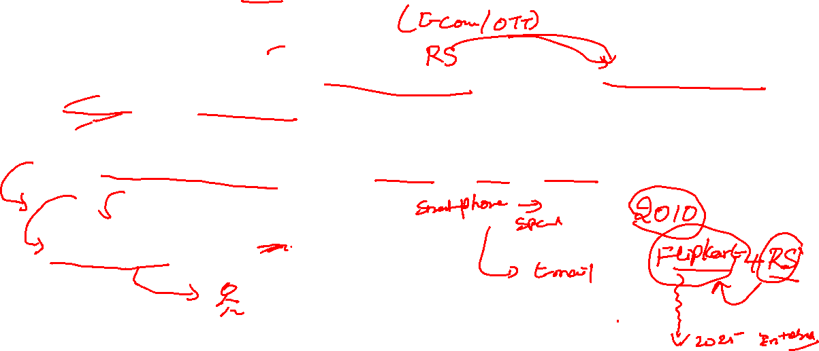
Introduction to AI in Search & Recommendations
What is a Recommendation Engine?
A recommendation engine (or recommender system) is an AI-powered system that predicts and suggests items a user is likely to be interested in, based on data about:
The user's past behavior (e.g., purchases, views, ratings)
Other users' behaviors
Item features (e.g., genre, category, price)

Slide 3
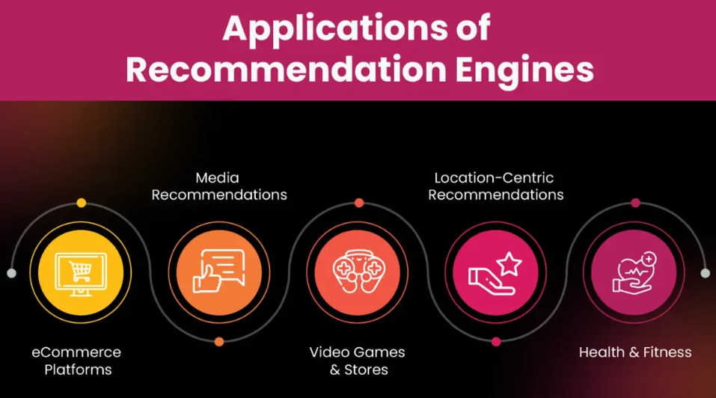
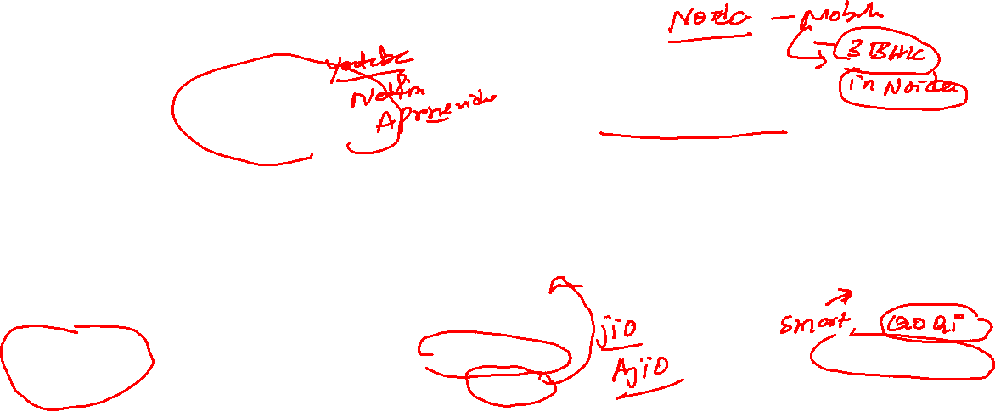
Introduction to AI in Search & Recommendations

Slide 4
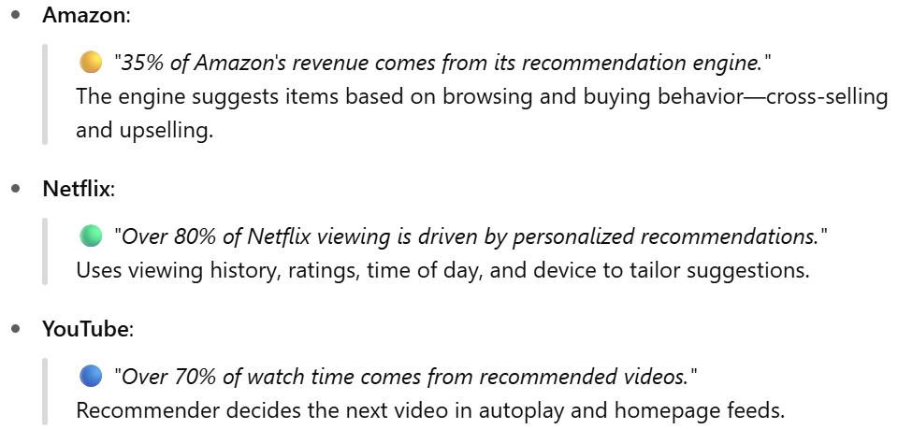
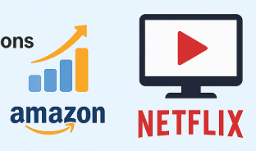

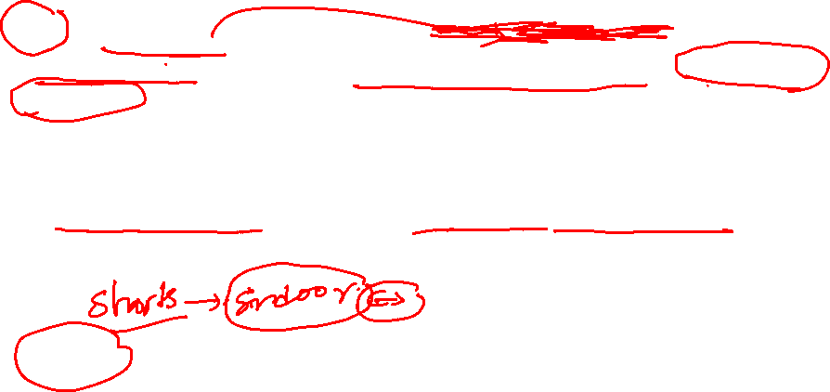
Why Search and Recommendation Matter

Slide 5
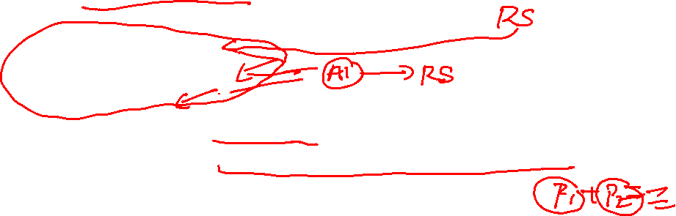
Business Motivation and Real-World Impact
Value in E-commerce (Amazon, Flipkart, etc.)
Amazon: 35% of total sales are driven by its recommendation engine.
Recommends products based on:
Purchase history
Browsing behavior
Cart content
Increases Average Order Value (AOV) through:
Cross-selling (“Customers who bought this also bought…”)
Upselling (“Frequently bought together”)
Impact: More conversions, higher customer retention, less cart abandonment

Slide 6
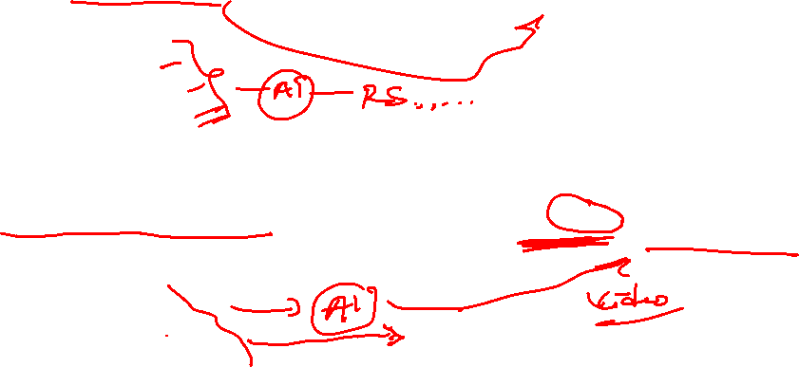
Business Motivation and Real-World Impact
Value in OTT Platforms (Netflix, YouTube, etc.)
Netflix: 80% of watched content comes from recommendations.
Uses:
Viewing history
Genre preference
Time/day of viewing
Creates personalized rows and thumbnails to capture attention
YouTube: >70% of watch time is driven by the “Up Next” recommender
AI models suggest content based on:
Watch duration
Likes/dislikes
User session behavior
Impact: More watch time → higher ad revenue → stronger loyalty

Slide 7
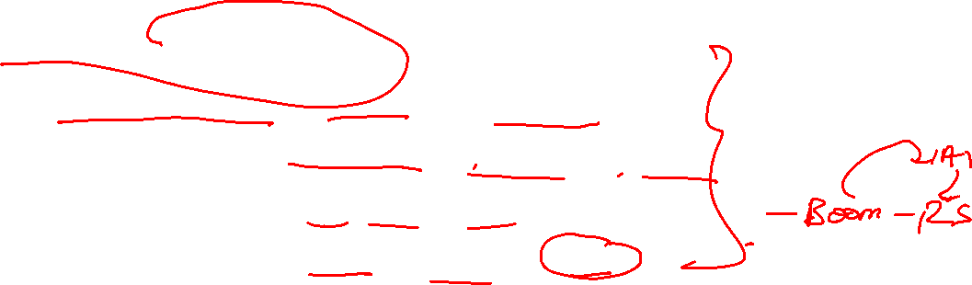
AI’s Role in Personalization
How AI Captures and Learns from User Behavior
AI models continuously learn from:
Browsing behavior (pages visited, time spent)
Purchase history (items bought, price range, categories)
Explicit feedback (likes, ratings, reviews)
Implicit feedback (dwell time, scrolling, skips)
AI builds a user profile that evolves over time
Learns preferences even without explicit input

Slide 8

AI’s Role in Personalization
Real-Time Adaptive Recommendation Mechanisms
AI systems adapt dynamically by:
Updating recommendations based on recent activity
Using context-aware filtering (e.g., time of day, location, device)
Re-ranking suggestions in real-time as user behavior changes during a session
Example:
Watch 3 comedy clips → Homepage shifts to comedy
Add a smartphone to cart → Accessories are prioritized

Slide 9
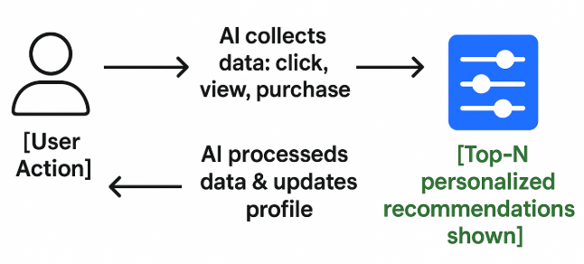

AI’s Role in Personalization
Recommendation Pipeline: User → AI → Output

Slide 10
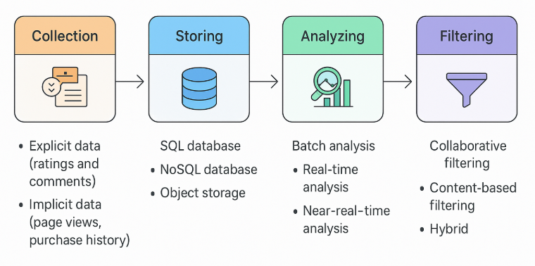
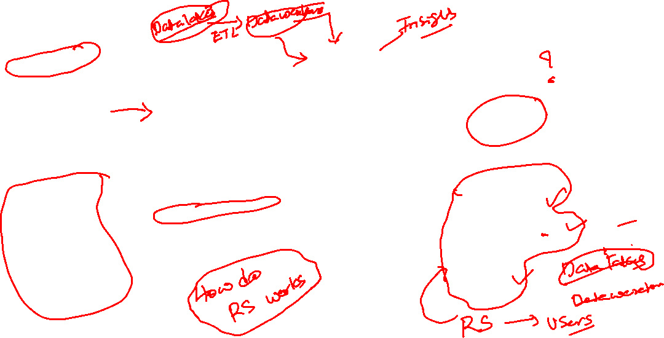
How do Recommendation System Works?

Slide 11
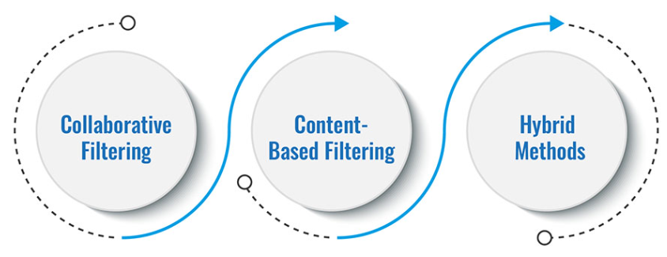

Types of Recommendation Systems
Types of Recommendation Systems

Slide 12

Types of Recommendation Systems
Content-based Filtering
Content-Based Filtering recommends items similar to those the user has liked in the past based on item features rather than other users’ behavior.
How It Works
Builds a profile of the user using their past preferences (e.g., watched movies, purchased products).
Builds a profile of each item using its attributes (e.g., genre, category, keywords).
Matches the user profile to new items with high feature similarity.

Slide 13
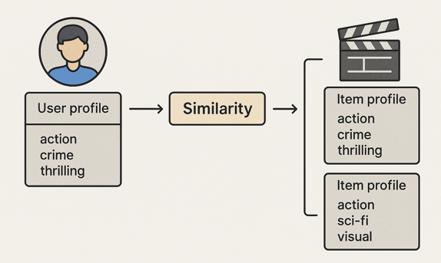
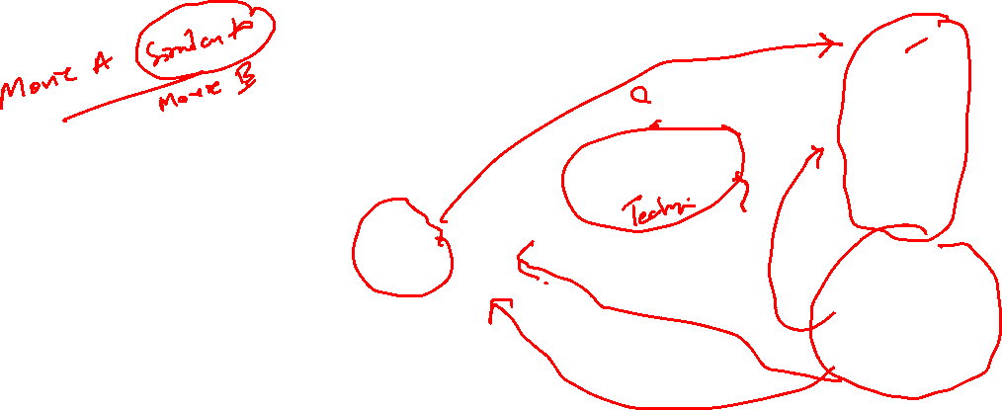
Types of Recommendation Systems
Content-based Filtering

Slide 14
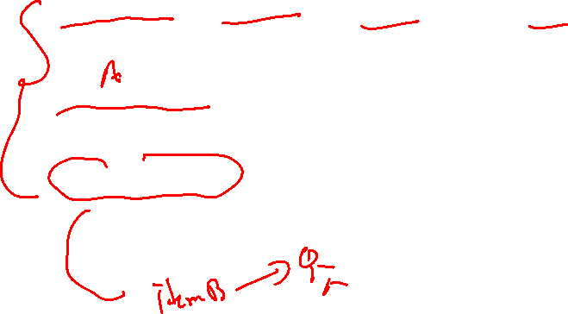
Types of Recommendation Systems
Content-based Filtering
Key Components
User Profile: Keywords, categories, or tags extracted from items the user interacted with.
Item Profile: Feature representation of items (e.g., genre = action, keywords = fast, intense, hero).
Similarity Metric: Measures how closely item features match the user’s preferences (e.g., cosine similarity).

Slide 15
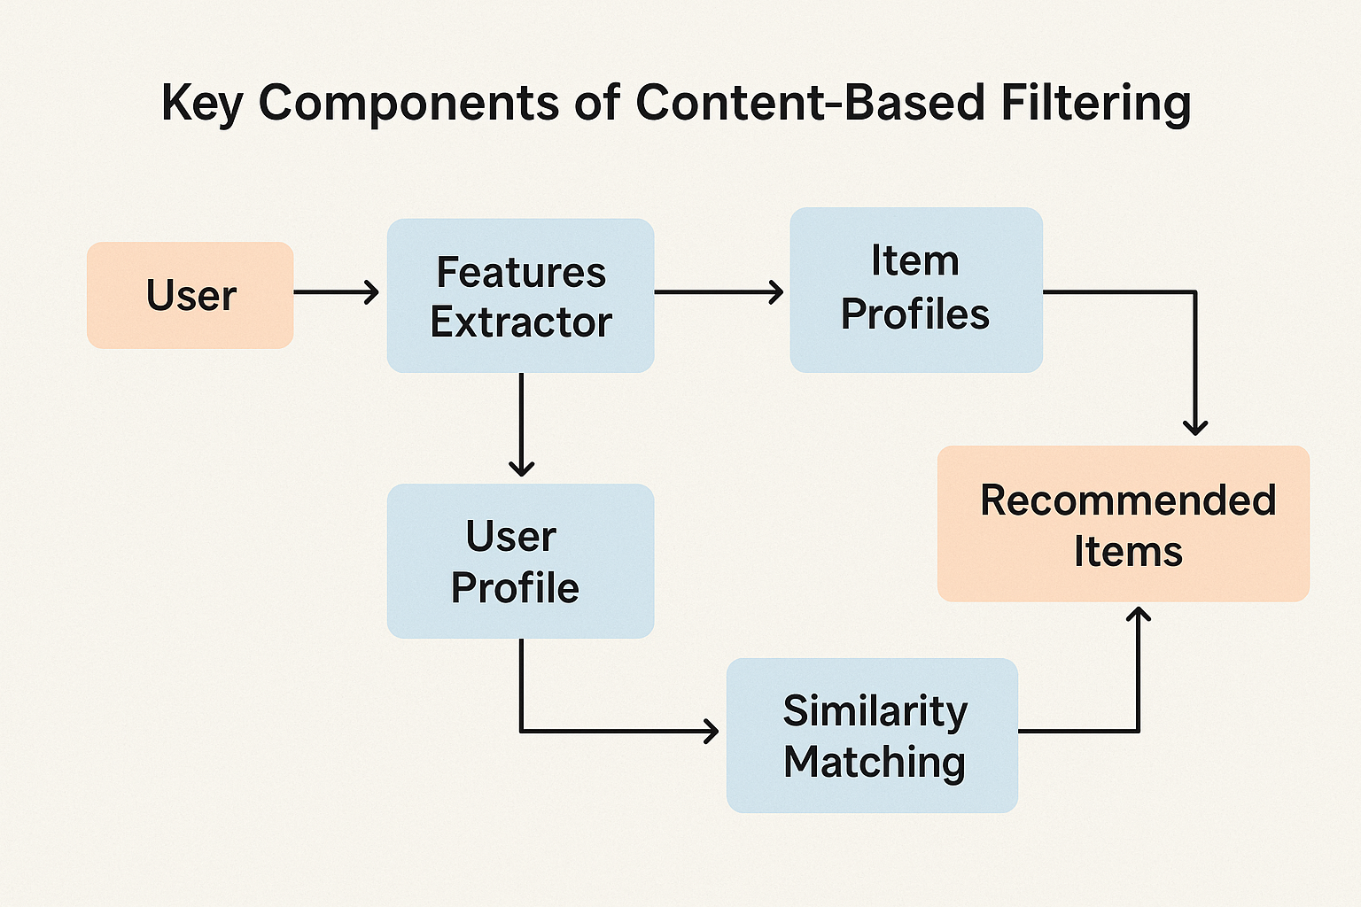

Types of Recommendation Systems
Content-based Filtering
Example: Movie Recommendation
A user watches action and thriller movies.
System suggests other movies with
similar genres, keywords, and actors.
“You liked John Wick, try Taken.”

Slide 16
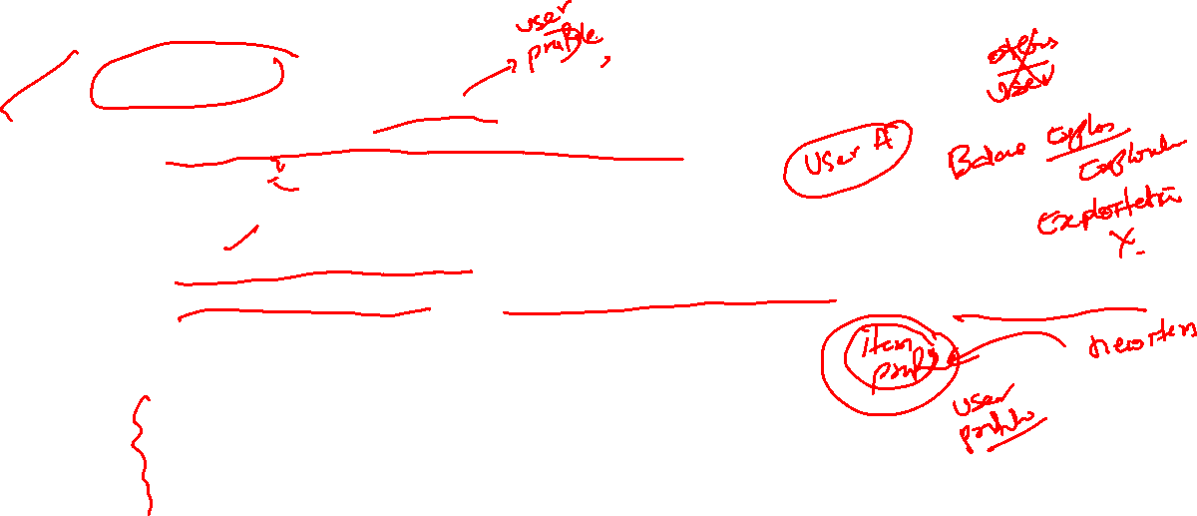
Types of Recommendation Systems
Content-based Filtering
Advantages
Works well for new users with known preferences.
Does not need data from other users.
Personalized to each user’s taste.
Limitations
Cold start for new items (no metadata = no recommendation).
Over-specialization: Recommends similar content only (no exploration).
Ignores the “wisdom of the crowd.”
Applications
News and article recommenders
Music streaming (genre, tempo, mood)
E-commerce (spec-based matching: brand, features)

Slide 17
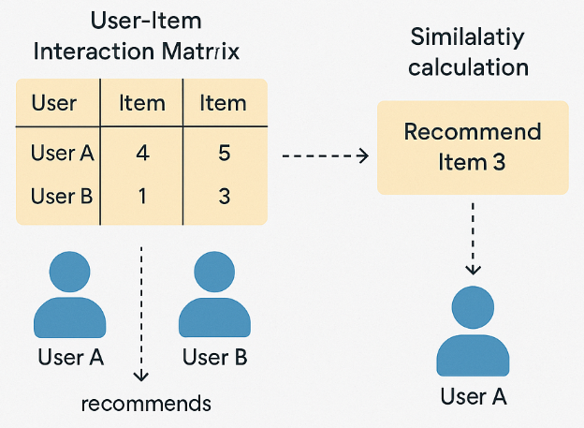
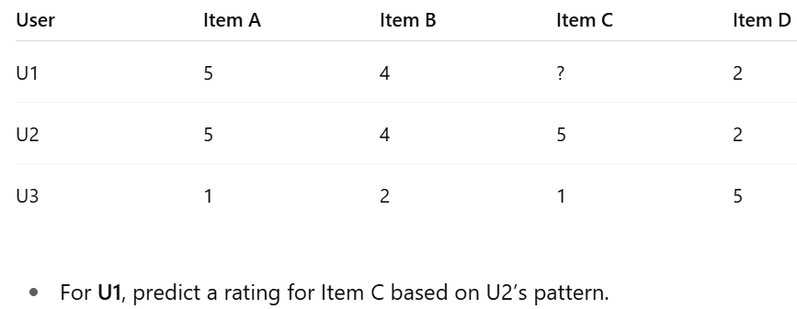
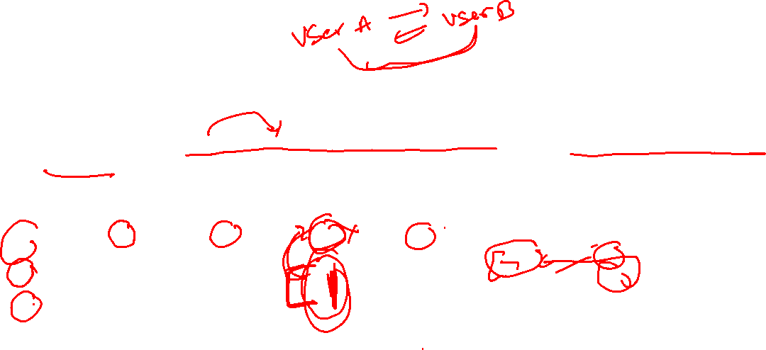
Types of Recommendation Systems
Collaborative Filtering
Collaborative Filtering recommends items by leveraging preferences and behaviors of other users.
Example: “If users A and B liked the same items in the past, they will likely like similar items in the future.”

Slide 18
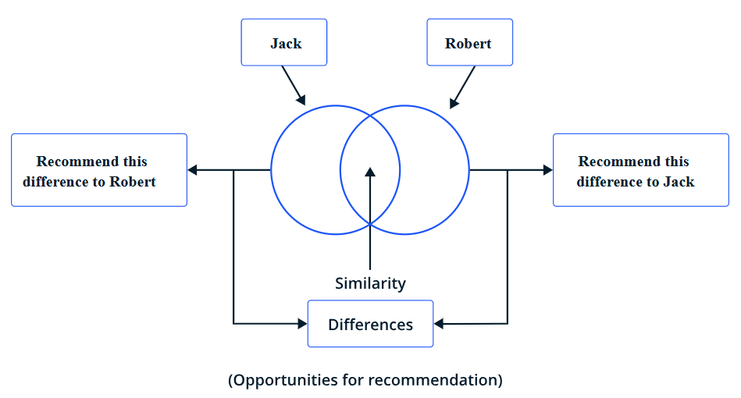
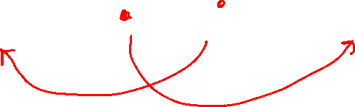
Types of Recommendation Systems
Collaborative Filtering

Slide 19
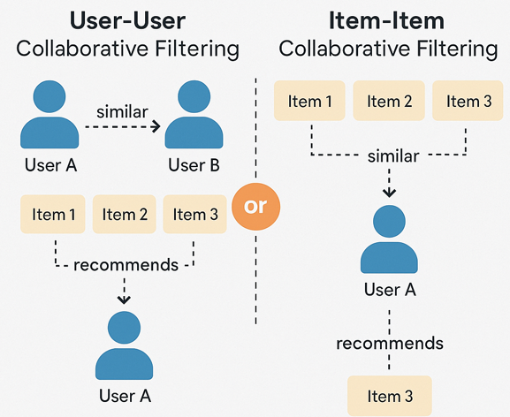
Types of Recommendation Systems
Collaborative Filtering: Types
User-User Collaborative Filtering
“You and John both liked Item X.
John liked Item Y. You might like Item Y too.
Item-Item Collaborative Filtering
“Users who liked Item A also liked Item B.”

Slide 20
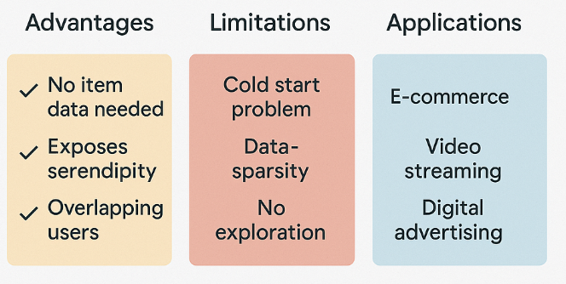
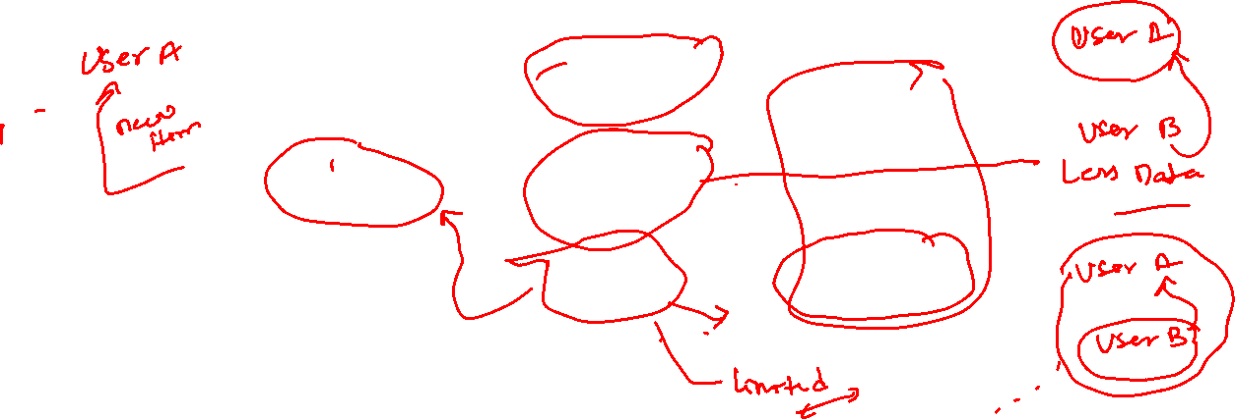
Types of Recommendation Systems
Collaborative Filtering

Slide 21
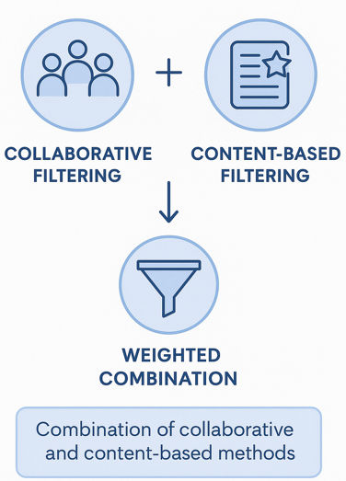
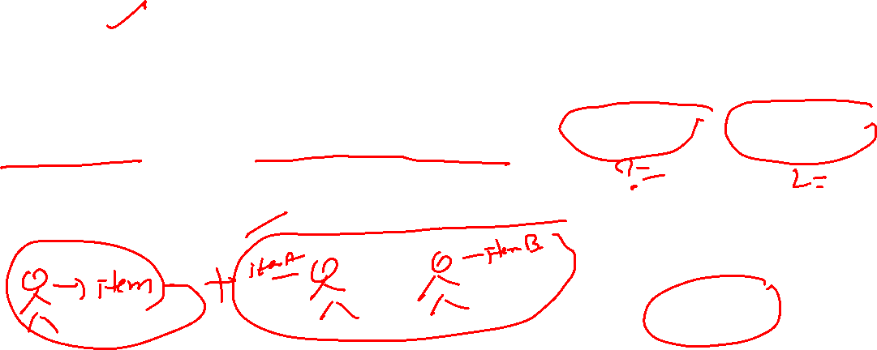
Types of Recommendation Systems
Hybrid Filtering
Hybrid Filtering combines two or more
recommendation techniques—typically
Collaborative Filtering and Content-Based Filtering
to overcome their individual limitations and improve
overall recommendation performance

Slide 22

Types of Recommendation Systems
Hybrid Filtering: Weighted Combination
Weighted Hybrid: Combine scores from both
methods using weighted average.
Switching Hybrid: Use one method when the
other fails (e.g., fallback to content-based during cold
start).
Mixed Hybrid: Show results from both systems
together.
Cascade Hybrid: Use one method to refine results
from the other.

Slide 23
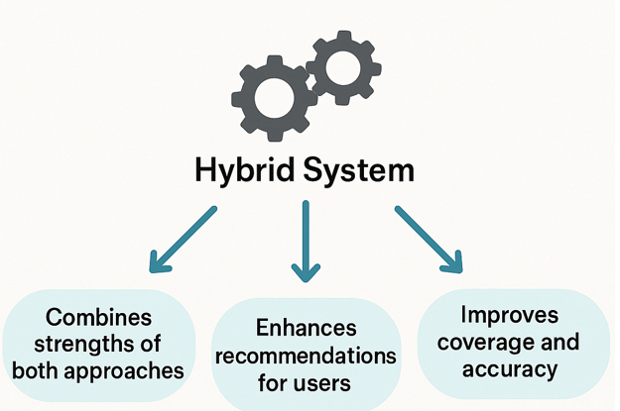
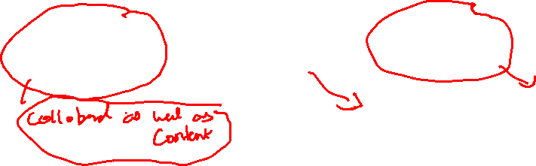
Types of Recommendation Systems
Hybrid Filtering: Why

Slide 24
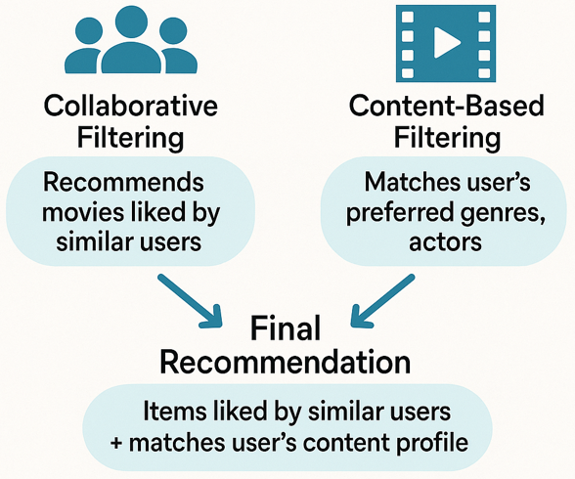

Types of Recommendation Systems
Hybrid Filtering: Example

Slide 25
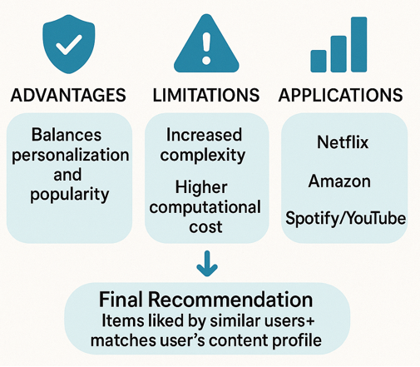
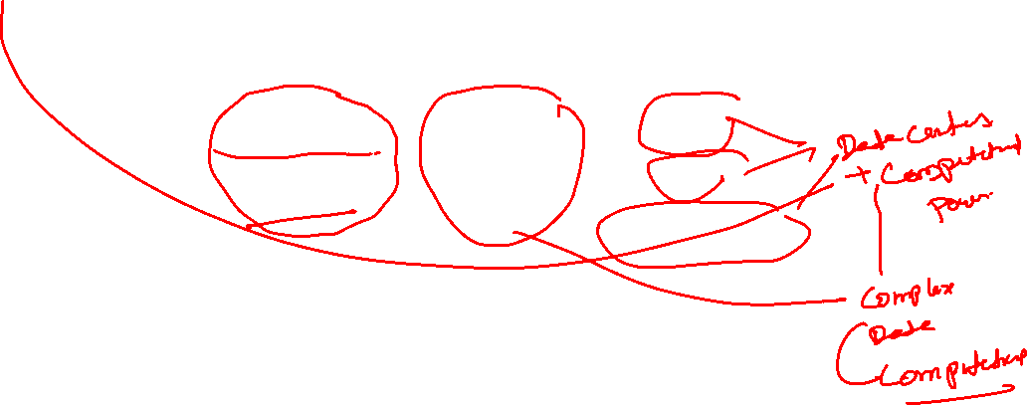
Types of Recommendation Systems
Hybrid Filtering

Slide 26
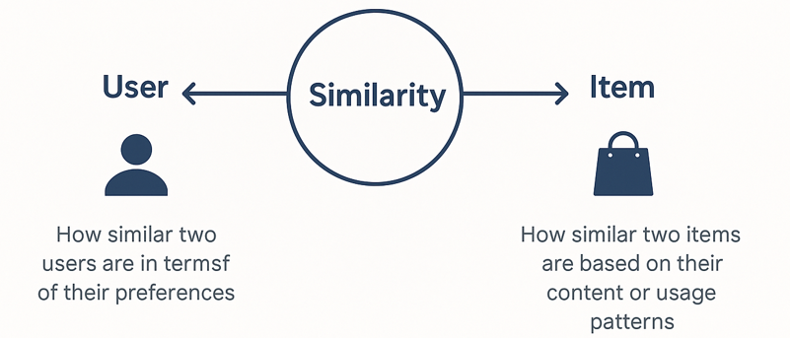
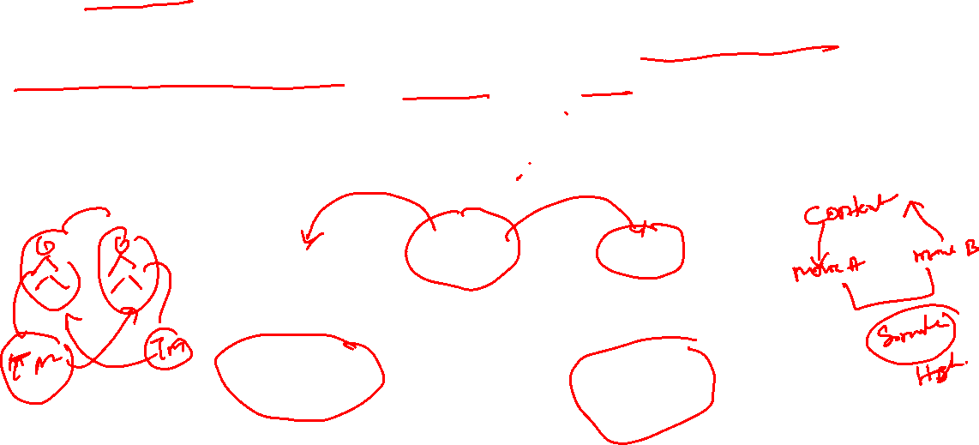
Similarity in Recommendation Systems
What is Similarity in Recommendation Systems?
Similarity in recommendation systems refers to the degree of closeness or likeness between two entities, such as users or items. It’s a quantitative measure used to determine:
How similar two users are in terms of their preferences
How similar two items are based on their content or usage patterns

Slide 27
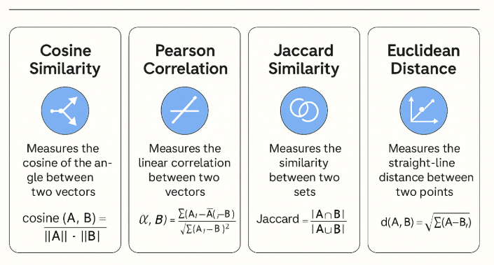
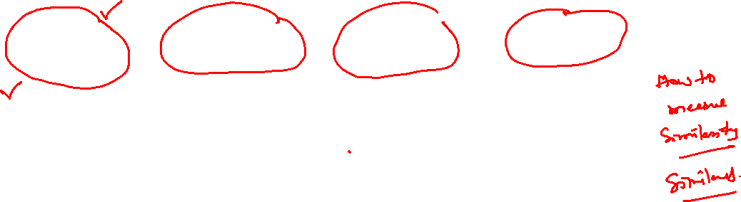
Similarity in Recommendation Systems

Slide 28
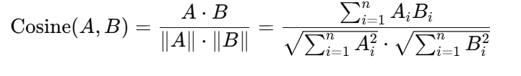

Similarity in Recommendation Systems
Cosine Similarity
Cosine Similarity measures how similar two vectors are by calculating the cosine of the angle between them in a multi-dimensional space.
It is widely used in Collaborative Filtering and Content-Based Filtering.
Values range from 0 (no similarity) to 1 (perfect similarity).

Slide 29
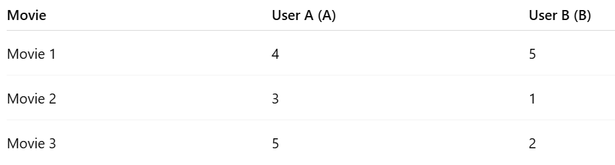
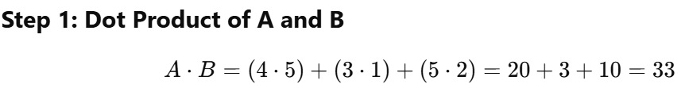
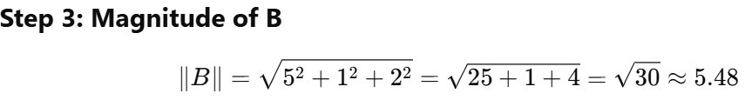
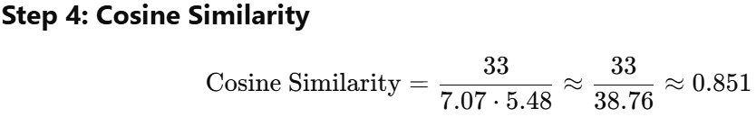
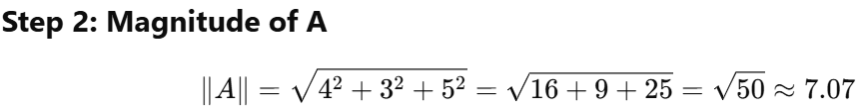
Similarity in Recommendation Systems
Cosine Similarity: Example

Slide 30
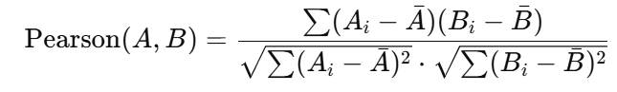
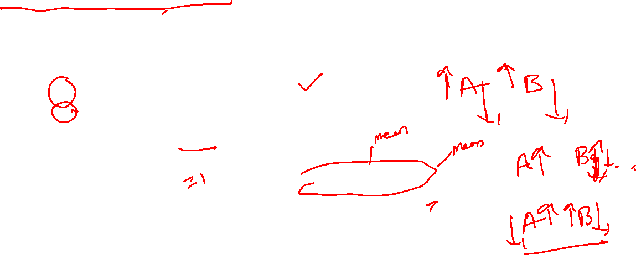
Similarity in Recommendation Systems
Pearson Correlation Coefficient
Pearson Correlation measures the linear relationship between two vectors by comparing how they vary together from their respective means.
Range: [−1,1][-1, 1][−1,1]
1 = perfect positive correlation
0 = no correlation
-1 = perfect negative correlation

Slide 31
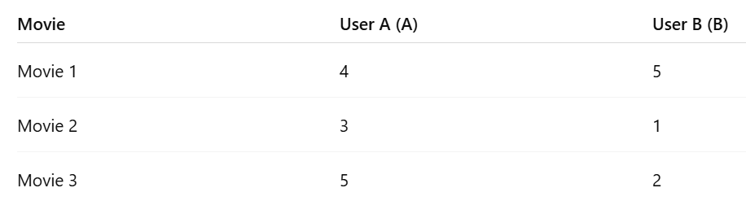
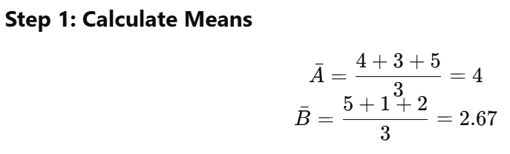
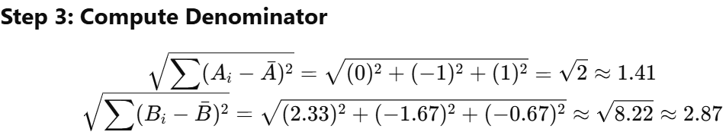
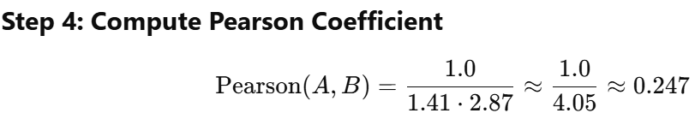
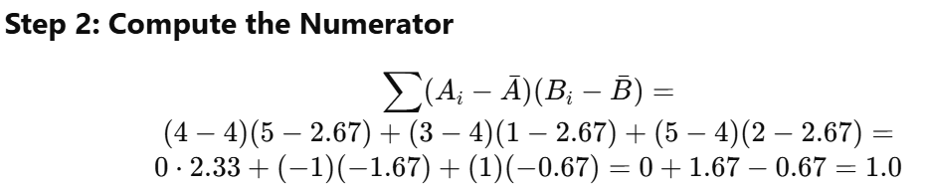

Similarity in Recommendation Systems
Pearson Correlation Coefficient: Example

Slide 32




Similarity in Recommendation Systems
Jaccard Similarity
Used for comparing binary vectors or sets (e.g., purchase history).
Euclidean Distance
Distance:

Slide 33


Evaluation of Recommendation Systems
Why Evaluate

Slide 34


Evaluation of Recommendation Systems
Evaluation Types

Slide 35


Evaluation of Recommendation Systems
Evaluation Metrics

Slide 36


Evaluation of Recommendation Systems
Evaluation : Predicitve Metrics

Slide 37


Evaluation of Recommendation Systems
Evaluation : Classification Metrics

Slide 38



Evaluation of Recommendation Systems
Evaluation : Ranking Metrics (for Top-N Recommendations)
These metrics help assess how well the relevant items are ordered in a recommended list. In Top-N tasks, the system recommends N items, and the goal is to have relevant items appear early in the list.
NDCG (Normalized Discounted Cumulative Gain)
Rewards relevant items that appear at higher ranks.
Uses a logarithmic scale to penalize lower-ranked items.

Slide 39


Evaluation of Recommendation Systems
Evaluation : Ranking Metrics (for Top-N Recommendations)
MRR (Mean Reciprocal Rank)
Measures the rank of the first relevant item.
Focuses on how early the system retrieves a relevant item.
Good when there's typically one relevant item per query

Slide 40

Evaluation of Recommendation Systems
Evaluation : Ranking Metrics (for Top-N Recommendations)
MAP (Mean Average Precision)
Computes average precision for each user and then averages over all users.
Ideal when multiple relevant items exist.

Slide 41

Use Cases: Netflix
What Is The Netflix Algorithm?
Netflix has over 230 million subscribers and 15,000+ titles.
80% of viewing comes from personalized recommendations.
Uses AI to predict what users want to watch based on behavior and preferences.
How Netflix’s Recommendation System Works
Origin: Netflix Prize (2006) improved Cinematch engine.
Incorporates reinforcement learning, matrix factorization, causal modeling, and multi-armed bandits.
UI design places highest-relevance titles top-left to capture attention.

Slide 42

Use Cases: Netflix
Step-by-Step: From Data to Recommendations
Step 1: Data Collection
User Data:
Viewing history
Time and day of viewing
Device/platform used
Ratings and likes
Hover/pause/rewind behavior
Search history
Content Data:
Genre, cast, crew
Release date, ratings
Language/subtitles
Viewer engagement and popularity

Slide 43

Use Cases: Netflix
Step-by-Step: From Data to Recommendations
Step 2: Data Processing & Analysis
Hybrid model: Collaborative filtering + Content-based filtering + Deep learning
Key algorithms:
Personalized Video Ranking (PVR)
Top-N Ranking
Popularity-based filtering
Uses AWS Cloud (EC2, S3, Lambda, SageMaker, DynamoDB)

Slide 44

Use Cases: Netflix
Step-by-Step: From Data to Recommendations
Step 3: Delivering Recommendations
Personalized UI with themed rows:
Because You Watched
Trending Now
Top Picks for You
New Releases
Continue Watching

Slide 45

Use Cases: Amazon
How Amazon’s Recommendation System Works
Integrates collaborative filtering, content-based filtering, and real-time behavioral data.
Recommendations are presented across:
Product detail pages
Shopping cart pages
Homepages and emails
Includes models such as:
"Customers who bought this also bought"
"Frequently bought together"
"Recommended for you

Slide 46

Use Cases: Amazon
Step-by-Step: From Data to Product Recommendations
Step 1: Data Collection
User Data:
Browsing history
Purchase history
Time spent on pages
Product clicks, cart additions, removals
Ratings, reviews
Device type and session time
Product Data:
Category, brand, price, features
User engagement (views, ratings, sales volume)
Inventory levels, availability, delivery time

Slide 47

Use Cases: Amazon
Step-by-Step: From Data to Product Recommendations
Step 2: Data Processing & Modelling
Uses item-item collaborative filtering and deep learning
Hybrid architecture:
Neural networks for feature embeddings
Behavioral clustering
Continuously updated using real-time interaction logs
AI uses insights to:
Rank items for product pages
Re-rank items in recommendations in milliseconds

Slide 48
Use Cases: Amazon
Step-by-Step: From Data to Product Recommendations
Step 3: Delivering Personalized Results
Custom carousels:
Inspired by your browsing history
Related to items in your cart
Items similar to recent purchases
Recommendations shown in:
Home feed
Product suggestions on PDPs
Checkout page upselling

Slide 49
THANK YOU

